Slide 1
Z-Score
Question: Can we compare the performance of 2 students from two separate classes, who took an exam on the same material?
Answer is yes - as long as we were confident that the exams were close in material and difficulty.
Then we could simply compare the actual values: Kiran got an 83 while Nikitha got an 89, so Nikitha performed better on the exam.
But what if the exams were NOT all that similar? Could we compare kiran and Nikitha then?
The answer is yes.
We can do it with the help of z-scores.
You see, z-scores has same basic ruler regardless of scale.

Slide 2
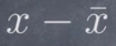
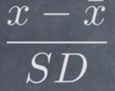
First, we start with the difference between a single score and the mean of the distribution that that score came from.
For Kiran, the mean of his distribution (or his class) was 74, while for Nikitha her mean was 80.
Kiran = 83 - 74
Nikitha = 89 - 80
Both Kiran and Nikitha show a difference to the mean of 9 points. But that's not the whole story: each distribution has a measure of center and a measure of SPREAD.
In our case, because we're assuming a normal, symmetrical distribution, the Standard Deviation is the measure of choice for spread.
We take the difference that we've already found, and we divide by the Standard Deviation of each distribution.
Kiran's distribution Standard Deviation is 4, while for Nikitha, her distribution Standard Deviation is 6.
(83 – 74)/4 = 2.25
(89 – 80)/6 = 1.5

Slide 3
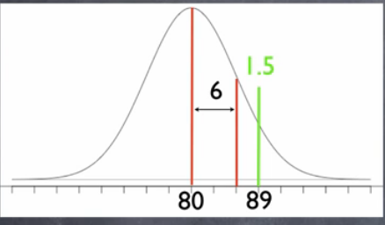
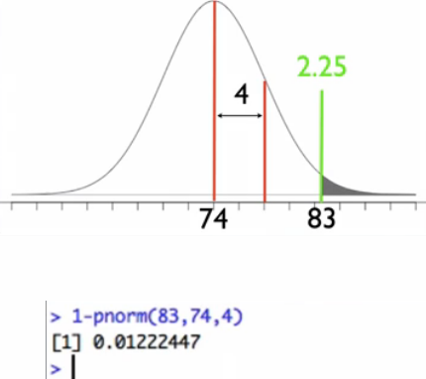
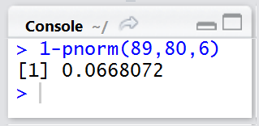
Let's take a look at Kiran and Nikitha again.
Here's Nikitha's score of 89 and here is her assumed normal distribution with a mean of 80 and a Standard Deviation of 6. And here's her corresponding z-score of 1.5.
Using a z-table or a function in R, we can find that roughly 7% of her class performed better than her.
While for John, on the other hand, with his specific distribution and his z score, we can see that only 1% performed better than him.

Slide 4
So, if we solve for both z-scores, we find that Kiran’s z-score of exam performance is 2.25, while for Nikitha, her z-score for her performance is 1.5.
So, who performed better?
Well Nikitha got a HIGHER raw score, but her class did better overall (maybe it was just an easier exam).
And more importantly, Nikitha's class had a larger SD. It had more spread around the mean.
So on the "ruler" of performance - Kiran was 2.25 units better than average, while, for Nikitha, she was only 1.5 units better than average.
And we call these particular units z-scores.

Slide 5
So, if we wanted to see who preformed better on an exam where kiran's exam was actually out of 100 and Nikitha's exam was out of 75 points, we could STILL do it.
We simply convert to z-scores first.
So, to answer our question of who did better on the exam, and get the added bonus of finding the percent of distribution that reflects that performance, we can use z-scores.

Slide 6
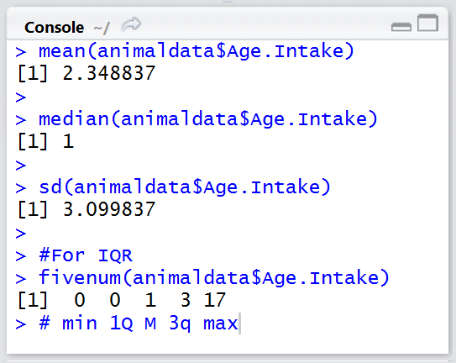
Another way to describe the amount of spread in a variable is to report the five-number summary, which consists of the minimum, the maximum, the median or halfway point, and then also the first and third quartiles, which are what you use to calculate the interquartile range, which is sometimes reported as a measure of spread.

Slide 7
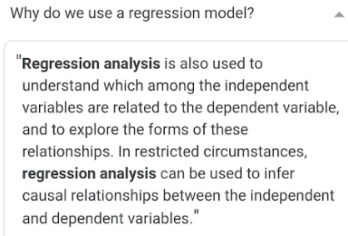
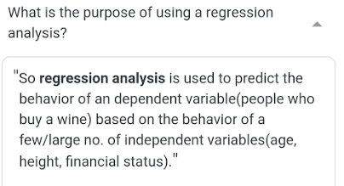
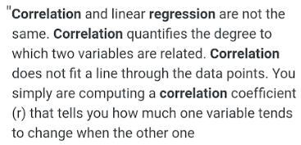
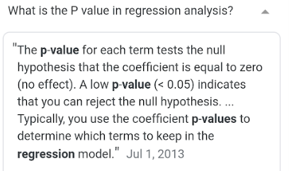
Linear Regression

Slide 8
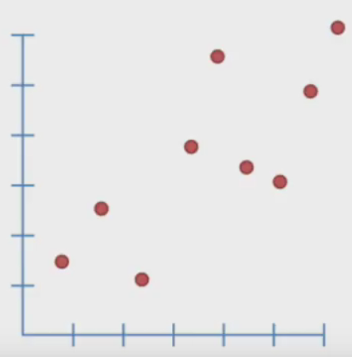
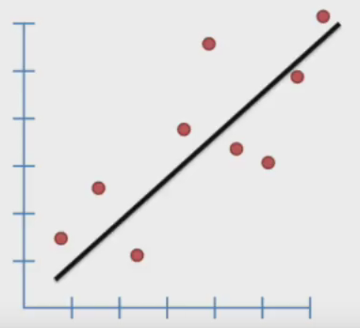
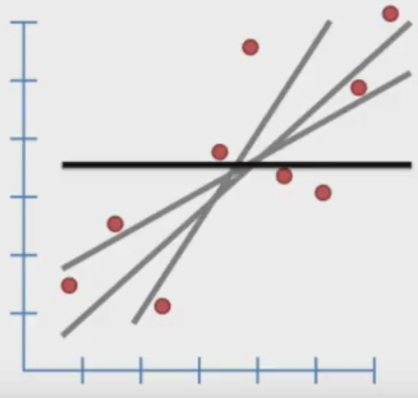
Fitting a line to data, least-squares, linear regression
You worked really hard, you did the experiment and now you got some data here it is plotted on an XY graph
We usually like to add a line to our data so we can see what the trend is, but is this the best line we should use
or does this new line fit the data even better or what about this line is it better or worse than the other options a horizontal line that cuts through the average Y value of our data is probably the worst fit of all

Slide 9
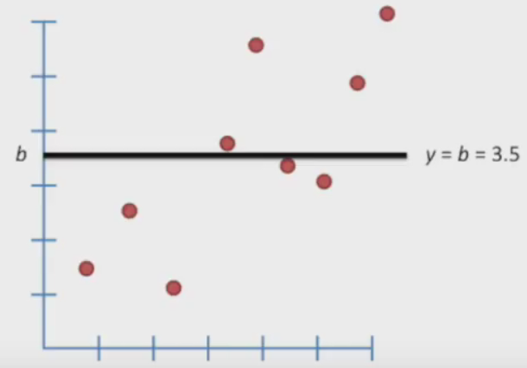
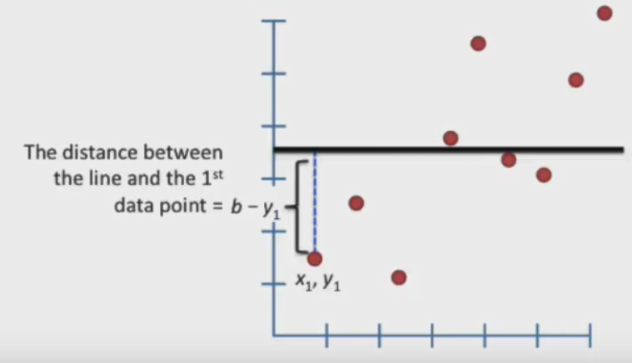
Fitting a line to data, least-squares, linear regression
Horizontal line cuts through the average Y value which is 3.5. Let's call this point B as different data sets will have different average values on the y- axis.
That is to say the Y value for this line is B and for this particular data set B=3.5 we can measure how well this line fits the data by seeing how close it is to the data points.
We'll start with the point in the lower left-hand corner of the graph with coordinates (x1,y1).
We can now draw a line from this point up to the line that cuts across the average Y value for this data set. The distance between the line and the first data point equals B-y1.

Slide 10
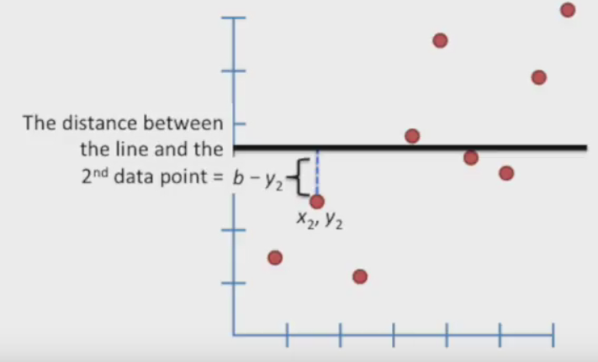
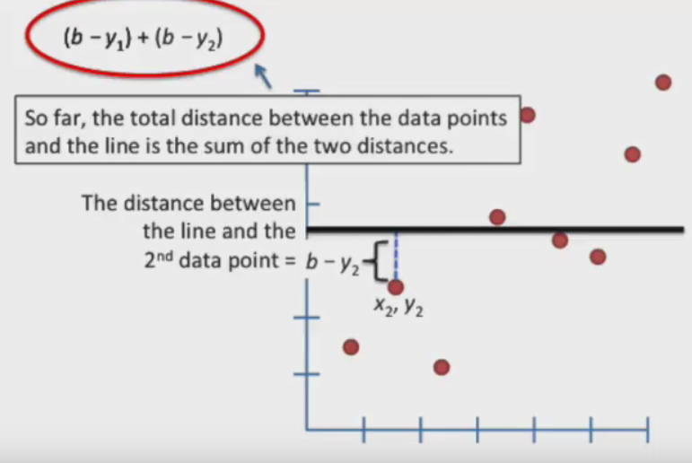
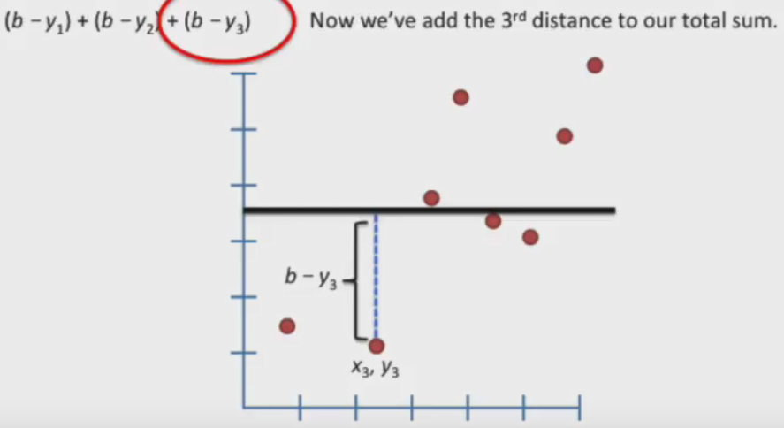
Fitting a line to data, least-squares, linear regression
Distance between the line and the second data point is B-y2.
Distances and we can calculate the distance between the line and the third point that equals B - y3 now we've added the third distance to our total sum

Slide 11
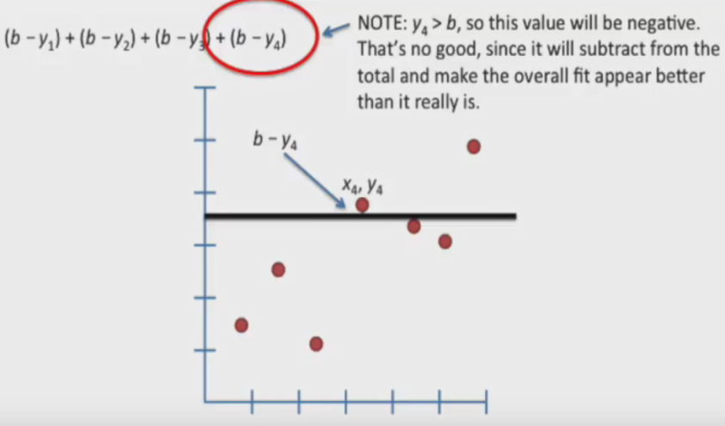
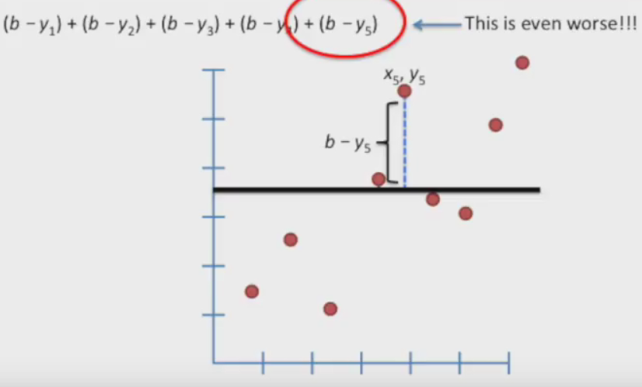
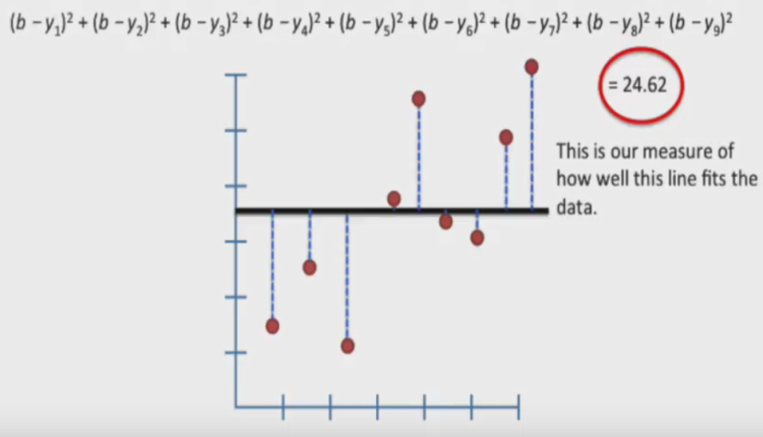
Fitting a line to data, least-squares, linear regression
Distance for the fourth point is B-y4 is greater than B because it's above the horizontal line so this value will be negative and it will subtract from the total and make the overall fit appear better than it really is.
Fifth data point is even higher relative to the horizontal line this distance is going to be negative.
Squaring each term squaring ensures that each term is positive
24.62 is our measure of how well this line fits the data it's called the sum of squared residuals because the residuals are the differences between the real data and the line and we are summing the square of these values.

Slide 12
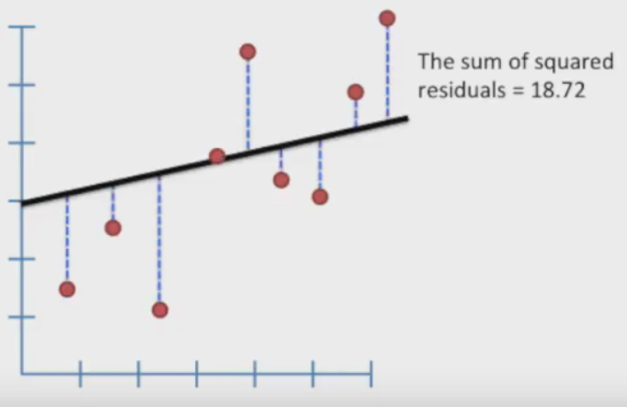
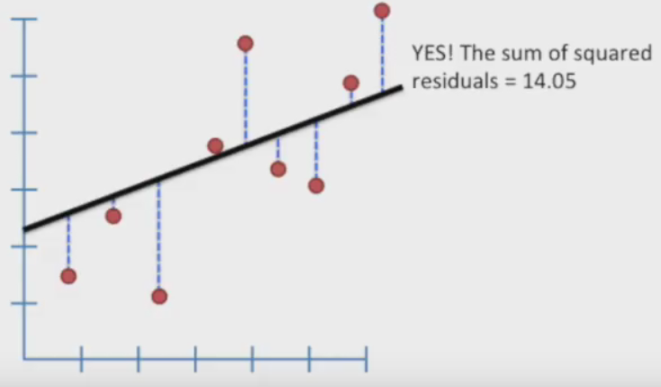
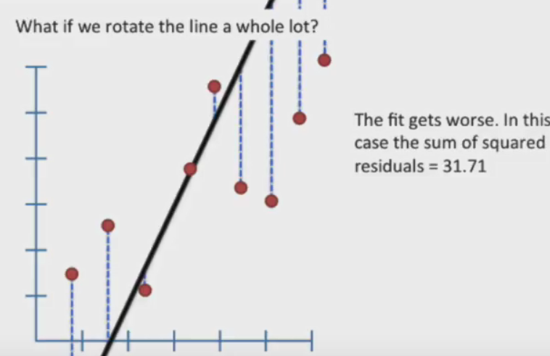
Fitting a line to data, least-squares, linear regression
Let's see how good the line fits if we rotate the line a little bit in this case the sum of squared residuals equals 18.72, this is better than before.
Does this fit improve if we rotate a little more.
Yes, the sum of squared residuals now equals 14.05, that value keeps going down, the more we rotate the line.
What if we rotate the line a whole lot, well as you can see the fit gets worse in this case the sum of squared residuals is 31.71.

Slide 13
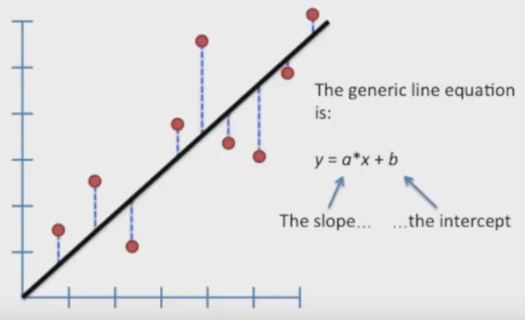
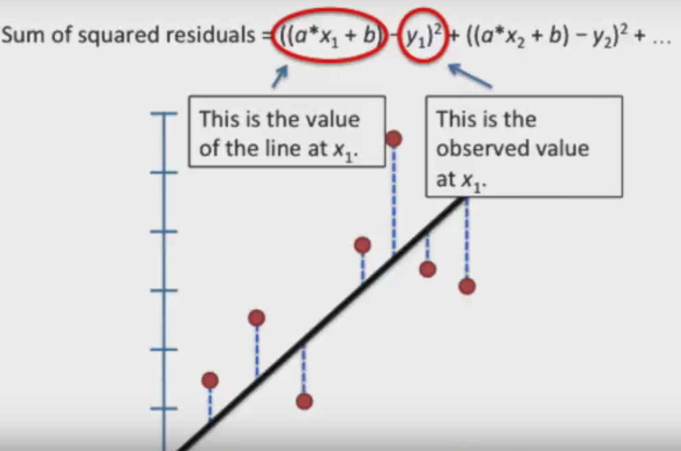
Fitting a line to data, least-squares, linear regression
So there's a sweet spot in between horizontal and two vertical to find that sweet spot.
Let's start with the generic line equation, this is y=ax+b,
a is the slope of the line
b is y-intercept of the line that's the location on the y axis that the line crosses when x equals 0.
We want to find the optimal values for a and b so that we minimize the sum of squared residuals.
First part is the value of the line at x1.
Second part is the observed value at x1.
All we're doing in this part of the equation is calculating the distance between the line and the observed value.
Since we want the line that will give us the smallest sum of squares for finding best values for a & b this method is called least squares.

Slide 14
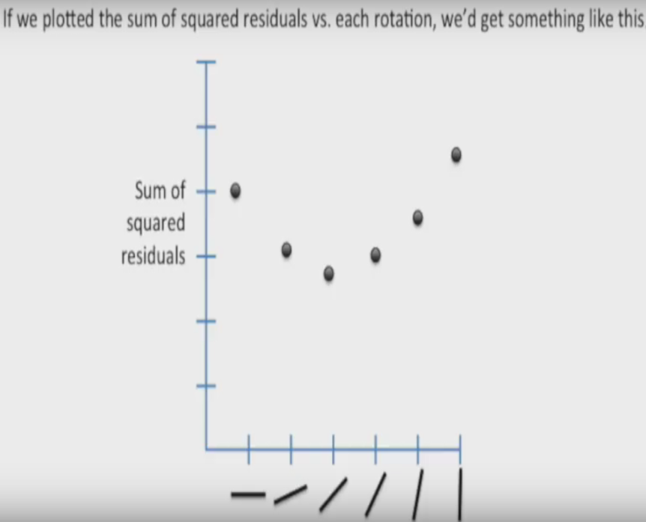
Fitting a line to data, least-squares, linear regression
Summary
We want to minimize the square of the distance between the observed values and the line.
We do this by taking the derivative and finding where it is equal to zero.
The final line minimizes the sums of squares, it gives the least squares between it and the real data.

Slide 15
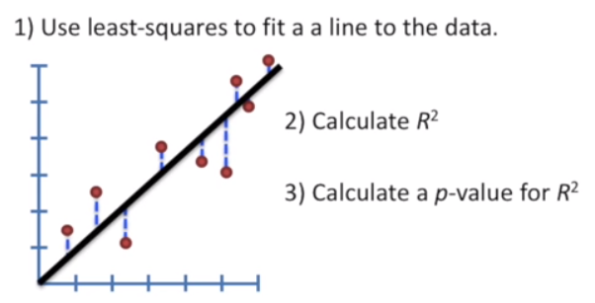
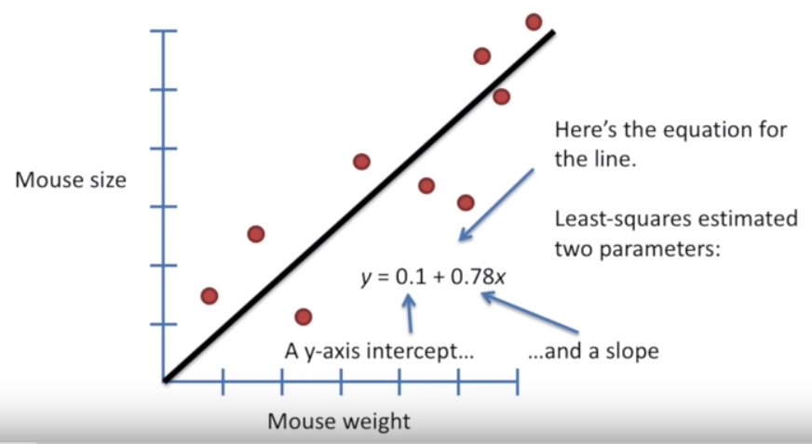
The Main Idea Behind Linear Regression
The Main Idea Behind Linear Regression is:
Use least square to fit a line to data.
Calculate R2
Calculate a p-value for R2
Consider there is a data set where we took a bunch of mice and we measured their size and we measured their weight.
Our goal is to use Mouse weight as a way to predict Mouse size.
Find the rotation that has the least sum of Squares.
The equation for the line, least squares estimated two parameters - a y-axis intercept and a slope.
Since the slope is not zero it means that knowing a mouse's weight will help us make a guess about that Mouse's size.
How good is that guess?
Calculating R2 is the first step in determining how good that guess will be.

Slide 16
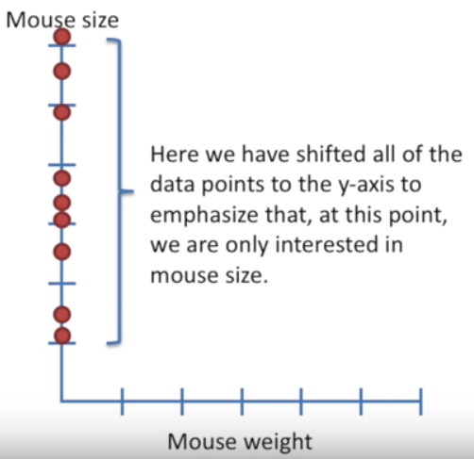
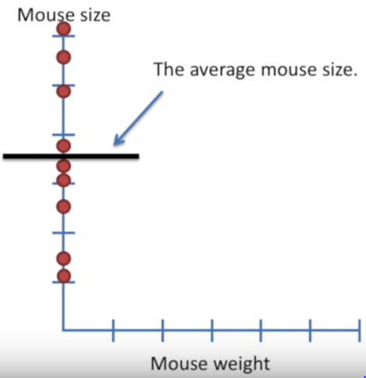
Calculating the R2
First calculate the average Mouse size

Slide 17
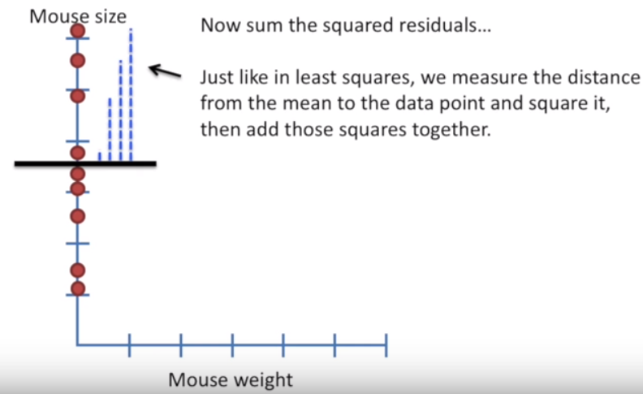
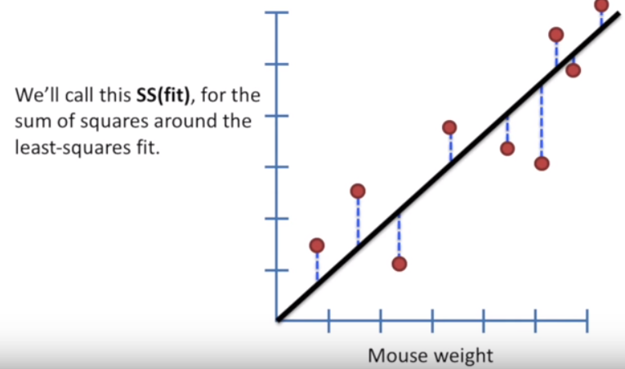
Calculating the R2
Sum the squared Residuals
We call this SS(mean) , for sum of squares around the mean
SS(mean)=(data-mean)2
Variation around the mean
var(mean) = (data-mean)2 / n = SS(mean) / n
n is the sample size, in our case its 9.
--------------------------------------------------------------------
SS(fit)=(data-line)2
var(fit)= (data-line)2 / n
var(fit)= SS(fit) / n
Variance(Something)= Average Sum of Squares.

Slide 18
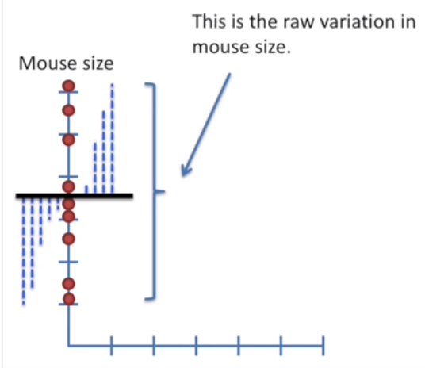
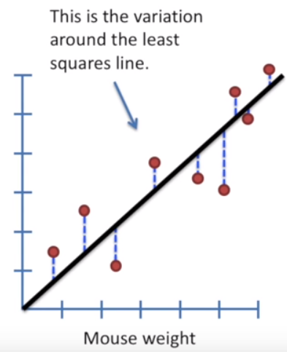
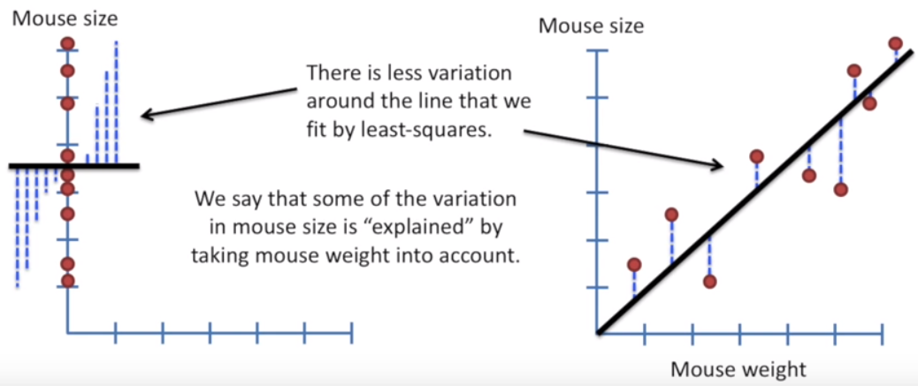
Comparing the R2 value with the least-square line
So we say that some of the variation in Mouse size is explained by taking Mouse weight into account.
In other words heavier mice are bigger and lighter mice are smaller.

Slide 19
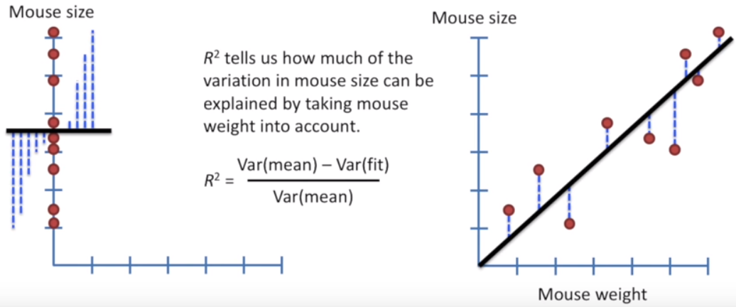
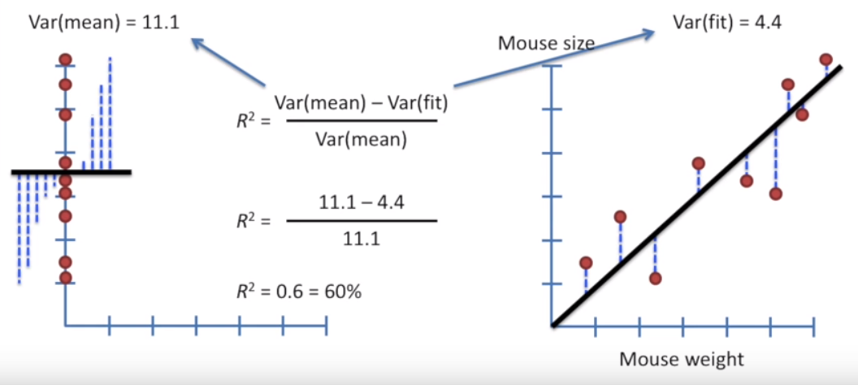
60% reduction in the variance when we take the mouse weight into account.
(OR)
Mouse weight explains 60% of the variation in Mouse size.

Slide 20
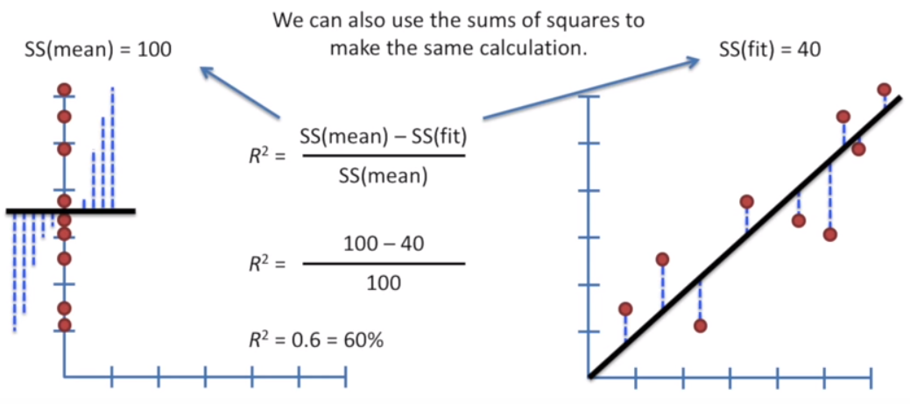
Using Sum of Squares to calculate R2
60% of the sum of squares of the mouse size can be explained by mouse weight.

Slide 21
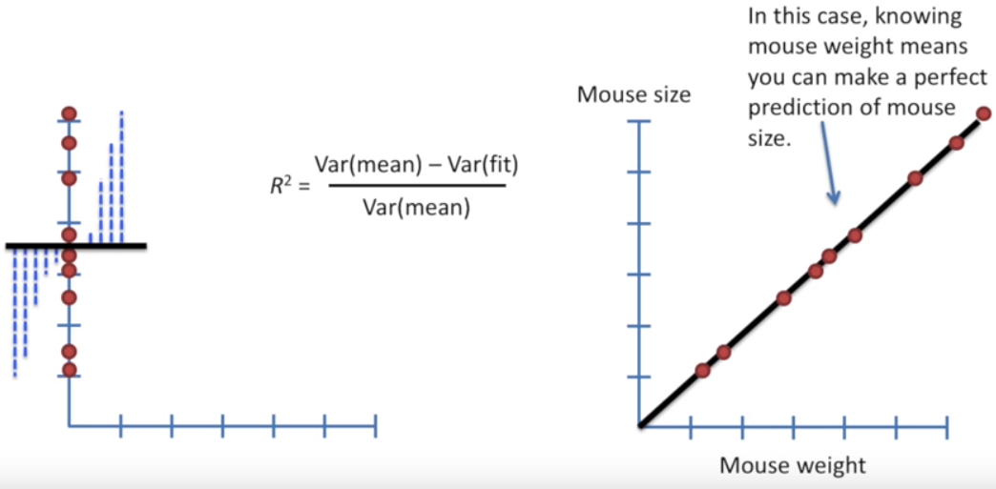
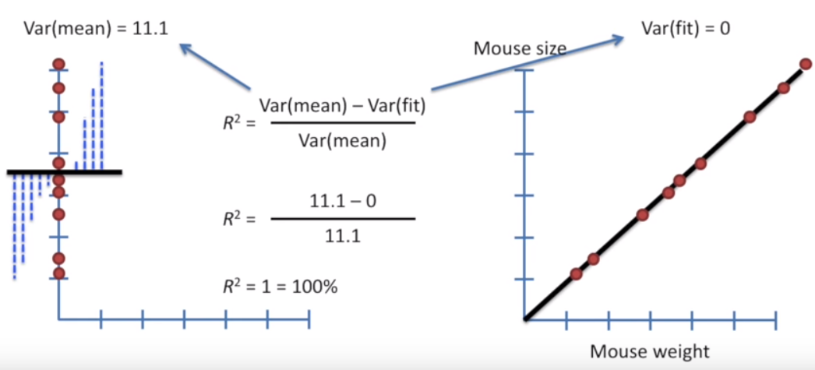
Example - 2
Mouse weight explains 100% of the variation in mouse size.

Slide 22
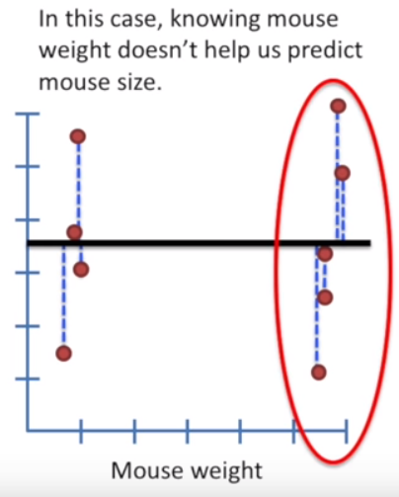
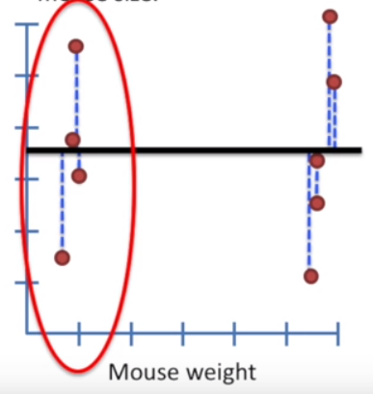
Example - 3
In this case knowing mouse weight doesn't help us predict Mouse size.
If someone tells us they have a heavy Mouse well that Mouse could either be small or large with equal probability.
Similarly if someone said they had a light Mouse, well again we wouldn't know if it was a big mouse or a small Mouse because each of those options is equally likely.

Slide 23
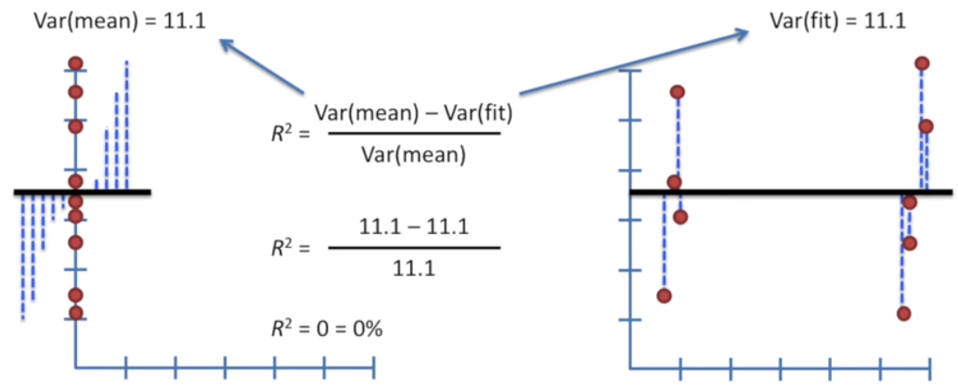
Example - 3
The variation around the mean is equal 11.1 and variation around the fit is also equal 11.1, so we plug those numbers in and we get R2=0 i.e 0%.
In this case mouse wait doesn‘t explain any of the variation around the mean when calculating the sum of squares around the mean.

Slide 24
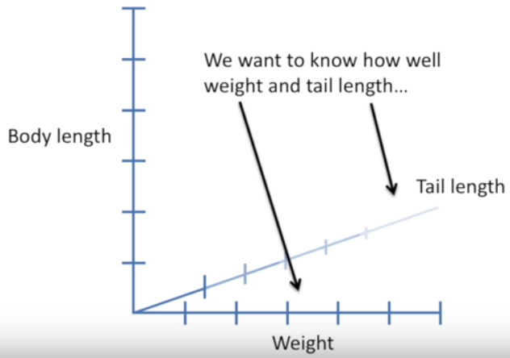
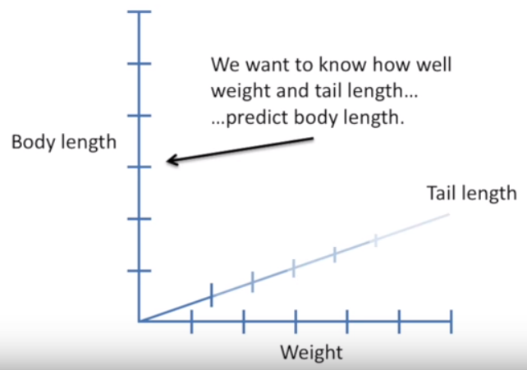
Multiple Regression
Imagine we wanted to know if Mouse weight and tail length did a good job predicting the length of the mouse's body.
Measure a bunch of mice. To plot this data we need a three-dimensional graph.
We want to know how well weight and tail length predict body length.

Slide 25
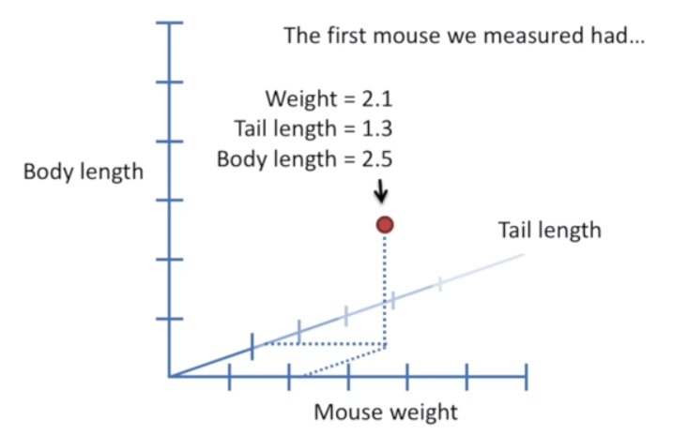
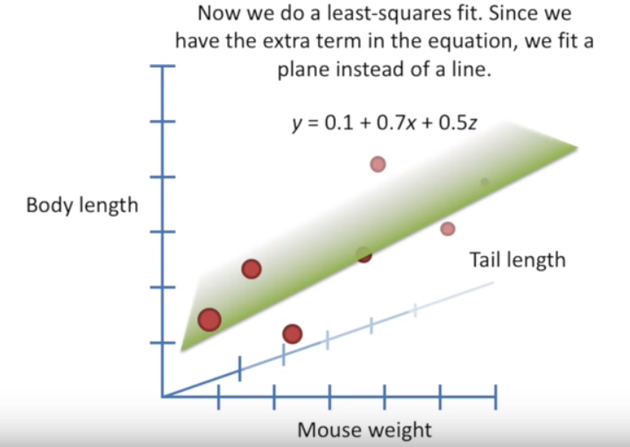
Multiple Regression
The first Mouse we measured had weight=2.1 & tail length=1.3 and body length=2.5, we plot this data on 3D graph.
The larger circles are points that are closer to us and represent mice that have shorter tails the smaller circles are points that are further from us and represent mice with longer tails.
Now we do a least-squares fit, since we have the extra term in the equation representing an extra dimension - we fit a plane instead of a line
The equation for the plane the
y-value represents body length.
Least squares estimates three different parameters:
y-intercept, that's when both tail length and mouse weight are equal to zero.
The second parameter 0.7 is for the mouse weight.
0.5 is for the tail length.

Slide 26
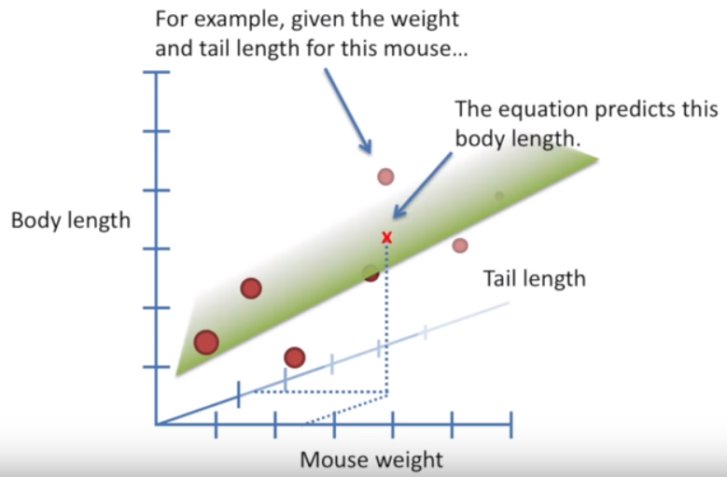
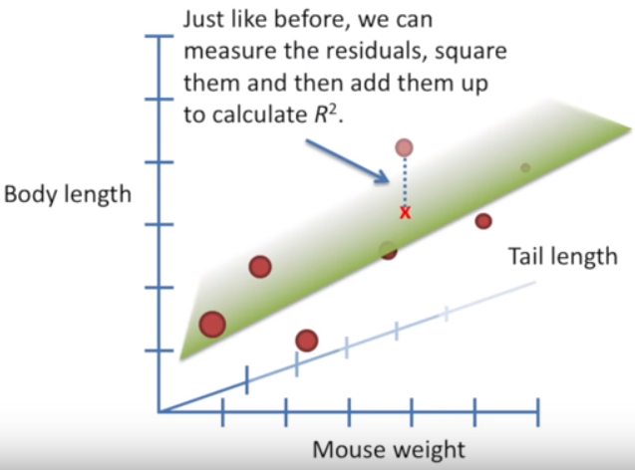
Multiple Regression
If we know a mouse's weight and tail length we can use the equation to guess the body length.
Given the weight and tail length for this mouse the equation predicts this body length.
Just like before we can measure the residuals, square them and then add them up to calculate R2.

Slide 27

Multiple Regression
If the tail length where the z-axis is useless and doesn't make the sum of squares fit SS(fit) smaller then least squares will ignore it by making that parameter=zero.
In this case plugging the tail length into the equation would have no effect on predicting the mouse size.
This means equations with more parameters will never make the sum of squares around the fit SS(fit) worse than equations with fewer parameters.

Slide 28
Multiple Regression
If the tail length where the z-axis is useless and doesn't make the sum of squares fit SS(fit) smaller then least squares will ignore it by making that parameter=zero.
In this case plugging the tail length into the equation would have no effect on predicting the mouse size.
This means equations with more parameters will never make the sum of squares around the fit SS(fit) worse than equations with fewer parameters.

Slide 29



Multiple Regression
In other words this equation:
Mouse size=0.3 + Mouse weight + flip of a coin + favorite color + astrological sign + extra stuff will never perform worse than equation
Mouse size=0.3+Mouse weight
This is because least squares will cause any term that makes sum of squares around the fit worse to be multiplied by 0 and in a sense no longer exists.
Now due to random chance there is a small probability that the small mice in the data set might get heads more frequently than large mice.
If this happened then we'd get a smaller SS(fit) and a better R2.
The more silly parameters we add to the equation the more opportunities we have for random events to reduce sum of squares fit and result in a better R2, thus people report an adjusted R2 value that in essence scales R2 by the number of parameters.

Slide 30





R2 is Awesome but its missing Something
It doesn’t mean anything.

Slide 31


Slide 32



Summary till R2

Slide 33



Calculating p-value for R2
p-value for R squared comes from something called “F-Distribution”.
Numerators for R2 and F distribution is same.

Slide 34


P-Value
The denominator is little different.
The difference between the data point and the fitted line is something that is not explained by weight.

Slide 35


Mathematical Equations for both R2 and p-value
ss(fit) in the denominator is the variation not explained by the weight.

Slide 36




Calculating p-value
Line fit has 2 parameters.
Y-intercept
Slope
P mean has only 1 parameter that is y-intercept.

Slide 37


Calculating p-value

Slide 38


Calculating p-value

Slide 39





How to convert the F value to p-value

Slide 40




How to convert the F value to p-value

Slide 41


How to convert the F value to p-value
Repeating this process N number of times and plotting it in an histogram we get this.
Then turn to original dataset and calculate F value.

Slide 42



How to convert the F value to p-value
Extreme values are 6 and 7 divided by all the other randomizations that we created originally.

Slide 43


Slide 44
Lets Code

Slide 45
#Mouse Weight to Size
mouse.data<-data.frame(weight=c(0.9,1.8,2.4,3.5,3.9,4.4,5.1,5.6,6.3),
size=c(1.4,2.6,1.0,3.7,5.5,3.2,3.0,4.9,6.3))
#Display the data
mouse.data
#Plot the data
plot(mouse.data$weight,mouse.data$size)
# Draw a linear Model
# y-Values(Mouse Size) = y-intercept + Slop * x-values (Mouse Weight)
#Size = y-intercept +Slope* Weight
mouse.regression<-lm(size~weight,data=mouse.data)
#All kind of data is found in Summary function
summary(mouse.regression)
#Add the regression Line
abline(mouse.regression,col="blue")

Slide 46





i.e you want the min value and the max value to be approximately same distance from 0.
Same with 1Q and 3Q and its also nice to have median close to 0.

Slide 47


These P values tests whether the estimates for intercepts and slope are equal to 0 or not. If they are equal to 0 then it means it has no much use In the model.

Slide 48


Generally we are not interested in the intercept, so doesn’t matter what its p value is.
However we want to know the p-value for weight to be less than 0.05.
That is we want it to be statistically significant.

Slide 49




Slide 50




Slide 51



Slide 52





Slide 53




Slide 54




Slide 55



Slide 56


Slide 57



Slide 58




Plug in Sum of Square around the Simple regression
instead of mean.
Plug in Psimple instead of Pmean. i.e the number of parameters in the Simple regression.

Slide 59


Slide 60
#Mouse Weight to Size
mouse.tail.data<-data.frame(weight=c(0.9,1.8,2.4,3.5,3.9,4.4,5.1,5.6,6.3),
size=c(1.4,2.6,1.0,3.7,5.5,3.2,3.0,4.9,6.3),
tail=c(0.7,1.3,0.7,2.0,3.6,3.0,2.9,3.9,4.0))
#Display the data
mouse.tail.data
#If we dont specify the X-axis and y-axis in Plot function, all the data columns will be
#Plotted against each other.
plot(mouse.tail.data)
#By plotting u can say that weight and tail are reasonable predictors for Size.
#So weight and tail are co-related.i.e they provide similar inofrmation and we dont need
#both of them in our model.
multiple.regression<- lm(size~weight+tail,data = mouse.tail.data)
#Laydown the summary of results
summary(multiple.regression)
#As we are doing multiple regression we are more interested in Adjusted R2 Value.

Slide 61




Slide 62



Slide 63



Slide 64


As we are working with multiple linear regression we are more interested with Adjusted R2 value.

Slide 65




Slide 66



Slide 67
EXAMPLE - 2

Slide 68
We're going to learn how to run a linear regression model in R.
And to do this, we're going to use the world records data set.
And we can see that this data set contains the world record time or distance of a various track and field events for both men and women.
We're going to be using the men's 800-meter event.
So we're going to be looking at the world-record time, which is housed in this record variable, as well as the year that the world record was broken.
We're going to see if we can model the record time as a function of the year.
So the first thing we're going to have to do is subset our data based off this event variable and only pick out the rows where the event is the men's 800-meter.

Slide 69
So we want to model the record time as a function of year.
So we're going to give it the year from our Men's 800 data frame, and then also the record time will be our dependent variable.
So we see year-- our independent variable-- along the horizontal axis, the record time along the vertical axis, and then along with all of our actual data points, we see the line of best fit plotted on the scatter plot.
Also in the console window, we see the estimates of our linear regression equation along with the model fit statistic, r squared.
So the intercept, or value of y when x is 0, is 346. And the slope, or change in y for every one unit increase in x, is negative 0.12.
So we can see that the world-record time for the 800 meters decreases by about 0.12 seconds per year.
We can also see that our model fits our data fairly well. Almost 94% of the variation in y can be explained by the variation in x.

Slide 70



Slide 71


Hands-On
learn how to make a scatter plot in R, which will show the relationship between two numeric variables.
And as a demonstration, we're going to use some variables from our bull riding data set.
Import bullriders.csv

Slide 72
So we see that this data set has 38 professional bull riders.
And we've got 18 variables that describe these riders, such as their
Height & weight
how many years they've been a professional bull rider
how many events they've ridden in for this year
how many buck outs, or attempts that they've gone out the gate on the bull for that year
how many successful rides they've had-- meaning they've stayed on for 8 seconds
Various other numeric variables that we can analyze here.

Slide 73
Look at buck outs variable. You can think of this as the number of attempts they've tried to stay on the bull for this season.
And we want to see if maybe it's linearly related to the number of years they've been professional bull riders, or maybe the number of events they've ridden in that year.
So we're going to look at the relationship between buck outs and those two variables.
Before you run any correlation analysis, you want to first confirm that the two variables you're going to analyze don't have some non-linear relationship.
Because correlation measures the strength and direction of the linear relationship, you need to confirm that the two variables are indeed linearly related.
And the best way to check for the assumption of linearity is to just make a scatter plot of the two variables.

Slide 74


There isn't a real clear linear relationship here.
It's just kind of a random scatter or cloud of points, meaning that a change in years pro doesn't really give us any information about how buck outs will change.
So when we see something like this, we're
expecting a correlation that's close to 0, or a very weak correlation.
And also, if we had to fit a linear model to this data, meaning a line of best fit, it would be pretty much flat.

Slide 75


Lets see how the line would fit through the data with another function. And that function is called abline.
So abline is going to produce over our scatterplot a model to the variables. Now because correlation is all about linearity, the linear relationship between two variables, we're going to use the lm function, which is a linear model function
In order to input these variables into the lm function, we're actually going to have to reverse the order. So we want to predict buck outs as a function of years pro.
~ means as a function of.

Slide 76
We got a pretty flat line fitting through this data, most of the data points falling pretty far away from this line, indicating that there's not a really strong linear relationship here.
Let's look at the relationship between another variable and buck outs.
Let's look at, instead of years pro as our independent variable, let's look at the number of events the riders participated in 2012.
Now if we think about the data set, it would make sense that the more events a rider participated in, the more attempts they would have at riding the bull.

Slide 77


And here we see that nice line. Most of the
Points are clustered closely to that line,
indicating a strong linear relationship.

Slide 78

How to calculate the correlation between two numeric variables.
Relation is fairly weak if It's very close to 0.
Remember, correlation close to -1 or 1 indicates a strong relationship.
Once you get close to 0, it indicates that there's no real relationship at all.
Now we could also see the same thing with our events and buck outs. See this strong, positive correlation of 0.99

Slide 79

Now besides giving the cor function pairs of variables separated by a comma, we could also ask it to give us a correlation matrix.
So we can use a trick here where we essentially make a vector of variable names. Lets call this one myvars
Then I can use the assignment key and give it a vector of variable names using C function.
So if I want to look at years pro and events and buck outs, I can put all variable names here that I want into a single vector called myvars.
Now if I then ask for cor of the bull data frame, and then I can index this by certain rows and columns

Slide 80




Slide 81
How has the men’s shotput world record changed over time? What about the women’s world record?
How many different types of events (e.g. "Mens 100m," "Womens shotput," etc.) are represented in the dataset?
In what year did Usain Bolt first break the world record for the men's 100m dash?
In what year did Usain Bolt first break the world record for the men's 100m dash?
Which variable tells us the record setting time or distance? The variable name in the dataset is:
What type of variable is this?
Which variable tells us when the record was broken? The variable name in the dataset is:
What type of variable is this?

Slide 82
Let's break this analysis into its required steps:
Create a subset of the dataset that contains only the World Record cases for men’s shotput.
Create a subset that contains only the World Record cases for women's shotput.
Create a scatterplot of year and record shotput distance: one for men and one for women.
Confirm from these plots that a linear model is appropriate.
Run a linear model for each event and then interpret the results.

Slide 83
Here is the code you will use:
#Subset the data menshot <- WR[WR$Event=='Mens Shotput',] womenshot <- WR[WR$Event=='Womens Shotput',]
#Create scatterplots plot(menshot$Year,menshot$Record,main='Mens Shotput World Records',xlab='Year',ylab='World Record Distance (m)',pch=16)
plot(womenshot$Year,womenshot$Record,main='Womens Shotput World Records',xlab='Year',ylab='World Record Distance (m)',pch=16)
#Run linear models linFit(menshot$Year, menshot$Record)
linFit(womenshot$Year,womenshot$Record)

Slide 84
Which variable will be on the x-axis of each scatterplot?
Which function will we use to fit a linear model to the world record data?
What is the dependent variable in our linear models?

Slide 85
How have the world record times for the men's and the women’s mile event changed over the years? We want to find the best-fitting linear model for men's pole vault world records since 1970.

Slide 86
Standard Deviation Vs Standard Error

Slide 87



Slide 88


Slide 89


Slide 90


Slide 91



Slide 92


Slide 93

CLUSTERING

Slide 94


CLUSTERING
Unsupervised learning means that the training data has no ground truth labels to learn from.
Supervised learning case you knew whether each image was a chair or not a chair.

Slide 95


Slide 96
But in the unsupervised case, all you have are the Xs you don’t have the Ys.
So what we are supposed to be doing is grouping together, observations that are somehow similar.
Unsupervised problems are much harder to evaluate and clustering those is a key unsupervised problem

Slide 97



Slide 98
Quality: What Is Good Clustering?
A good clustering method will produce high quality clusters with
high intra-class similarity
low inter-class similarity
The quality of a clustering result depends on both the similarity measure used by the method and its implementation
The quality of a clustering method is also measured by its ability to discover some or all of the hidden patterns

Slide 99
K-Means Clustering
We will use the iris dataset from the datasets library.
What is K Means Clustering?
K Means Clustering is an unsupervised learning algorithm that tries to cluster data based on their similarity.
Unsupervised learning means that there is no outcome to be predicted, and the algorithm just tries to find patterns in the data.
In k means clustering, we have to specify the number of clusters we want the data to be grouped into.
The algorithm randomly assigns each observation to a cluster, and finds the centroid of each cluster.
Then, the algorithm iterates through two steps:
Reassign data points to the cluster whose centroid is closest.
Calculate new centroid of each cluster.
These two steps are repeated till the within cluster variation cannot be reduced any further.
The within cluster variation is calculated as the sum of the euclidean distance between the data points and their respective cluster centroids.

Slide 100


Slide 101


K- Means
K Means Clustering Examples and Practical Applications

Slide 102



Slide 103



Slide 104

K-means Algorithm (3)

Slide 105




Slide 106




Slide 107




Slide 108




Slide 109




Slide 110



Slide 111




Slide 112



Slide 113


Slide 114



Slide 115
Example

Slide 116

Visualization Example

Slide 117


Slide 118


Slide 119


Slide 120


Slide 121

K-means
Ask user how many clusters they’d like. (e.g. k=5)

Slide 122
K-means
Ask user how many clusters they’d like. (e.g. k=5)
Randomly guess k cluster Center locations

Slide 123
K-means
Ask user how many clusters they’d like. (e.g. k=5)
Randomly guess k cluster Center locations
Each datapoint finds out which Center it’s closest to. (Thus each Center “owns” a set of datapoints)

Slide 124
K-means
Ask user how many clusters they’d like. (e.g. k=5)
Randomly guess k cluster Center locations
Each datapoint finds out which Center it’s closest to.
Each Center finds the centroid of the points it owns

Slide 125
K-means
Ask user how many clusters they’d like. (e.g. k=5)
Randomly guess k cluster Center locations
Each datapoint finds out which Center it’s closest to.
Each Center finds the centroid of the points it owns…
…and jumps there
…Repeat until terminated!

Slide 126

K-means Start
Advance apologies: in Black and White this example will deteriorate
Example generated by Dan Pelleg’s super-duper fast K-means system:
Dan Pelleg and Andrew Moore. Accelerating Exact k-means Algorithms with Geometric Reasoning. Proc. Conference on Knowledge Discovery in Databases 1999, (KDD99) (available on www.autonlab.org/pap.html)

Slide 127

K-means continues…

Slide 128

K-means continues…

Slide 129

K-means continues…

Slide 130

K-means continues…

Slide 131

K-means continues…

Slide 132

K-means continues…

Slide 133

K-means continues…

Slide 134

K-means continues…

Slide 135

K-means terminates

Slide 136
The K-Means Clustering Method (4)
Example
10
10
9
9
8
8
7
7
6
6
5
5
4
Assign each objects to most similar center
Update the cluster means
4
3
3
2
2
1
1
0
0
0
1
2
3
4
5
6
7
8
9
10
0
1
2
3
4
5
6
7
8
9
10
reassign
reassign
K=2
Arbitrarily choose K object as initial cluster center
Update the cluster means

Slide 137
What Is the Problem of the K-Means Method?
The k-means algorithm is sensitive to outliers !
Since an object with an extremely large value may substantially distort the distribution of the data.
K-Medoids: Instead of taking the mean value of the object in a cluster as a reference point, medoids can be used, which is the most centrally located object in a cluster.
10
10
9
9
8
8
7
7
6
6
5
5
4
4
3
3
2
2
1
1
0
0
1
2
3
4
5
6
7
8
9
10
0
0
1
2
3
4
5
6
7
8
9
10

Slide 138

Exploring the data
The iris dataset contains data about sepal length, sepal width, petal length, and petal width of flowers of different species.
Let us see what it looks like:

Slide 139

After a little bit of exploration, I found that Petal.Length and Petal.Width were similar among the same species but varied considerably between different species, as demonstrated below:
new_iris=iris
plot(new_iris[c("Sepal.Length","Sepal.Width")],col=c("Red","Green","Blue"))

Slide 140

Clustering
Since we know that there are 3 species involved, we ask the algorithm to group the data into 3 clusters
.
new_iris$Species=NULL
plot(new_iris[c("Sepal.Length","Sepal.Width")],col=kc$cluster)
points(kc$centers[,c("Sepal.Length","Sepal.Width")],col=1:3,pch=8,cex=2)

Slide 141


Let us compare the clusters with the species
par(mfrow=c(2,2))
plot(new_iris[c("Sepal.Length","Sepal.Width")],col=kc$cluster) plot(new_iris[c("Sepal.Length","Sepal.Width")],col=iris$Species)

Slide 142
data_iris=iris
index=sample(1:nrow(data_iris),size=0.5*nrow(data_iris))
#Partitioning Actual data
training_comp=data_iris[index,]
test_comp=data_iris[-index,]
data_iris$Species=NULL
#Partitioning of trimmed data
training_data=data_iris[index,]
test_data=data_iris[-index,]
#Train the Model
results<-kmeans(training_data,3)
#Compare training Set with the result model
table(training_comp$Species,results$cluster)
#Compare test Set with the result model
table(test_comp$Species,results$cluster)
#Plot the results
plot(training_data[c("Petal.Length","Petal.Width")],col=results$cluster)
plot(test_data[c("Petal.Length","Petal.Width")],col=results$cluster)

